Slide 1



What’s the scoop on SCoOP?
Scottish Care of Older People - National Audit
BGS Scotland & NRS Ageing Specialty Group Spring Meeting 2019
Contacts: g.ellis@nhs.net; phyo.myint@abdn.ac.uk

Slide 2
What’s the scoop on SCoOP?
Background – Dr Christine McAlpine
Update on progress – Dr Alison Donaldson
Future vision – Prof Phyo Myint
Contacts: g.ellis@nhs.net; phyo.myint@abdn.ac.uk

Slide 3
Scottish Care of Older People (SCoOP) audit
- Background
Contacts: g.ellis@nhs.net; phyo.myint@abdn.ac.uk

Slide 4
What is SCoOP?
The Scottish Care of Older People (SCoOP) audit programme aims to assess specialist service provision for older people with frailty in Scotland, and provide benchmarking data for improving services.
Hospital services in Scotland are inspected regularly for various purposes and reports produced but using the data for improvement work can be difficult without some data on how services are being provided
Contacts: g.ellis@nhs.net; phyo.myint@abdn.ac.uk

Slide 5
A key goal was to ensure clinicians were aware of and engaged with the audit
It was launched at the BGS Scotland meeting in Aberdeen November 2017
Data is collected via BGS nominated representatives from each Health Board
Alison will outline what’s been achieved so far
Contacts: g.ellis@nhs.net; phyo.myint@abdn.ac.uk

Slide 6
            SCoOP goals
Improve patient safety, quality and standards of care
Ensure fair and equitable access to care
Highlight service variations across the country, and help avoid a ‘postcode lottery’ in the care an older person receives
Inform the work of Health and Social Care partnerships across Scotland, who are responsible for delivering care for older people
SCoOP could pave the way for better and equitable care for older people in the UK NHS, and set gold standards as a good practice guide
Contacts: g.ellis@nhs.net; phyo.myint@abdn.ac.uk

Slide 7
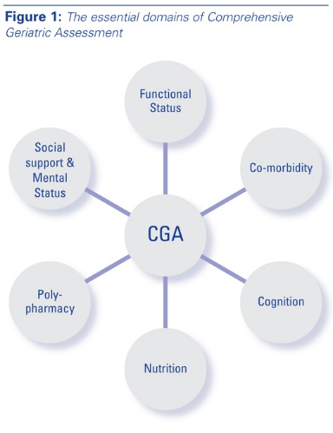
In summary SCoOP is asking:
We all know about CGA but do we know if we are doing it effectively?
Or could do it better?
Contacts: g.ellis@nhs.net; phyo.myint@abdn.ac.uk

Slide 8
What should we achieve with the SCoOP audit?
a ‘data picture’ of each service
local ownership of these ‘pictures’ – people who work there need to be satisfied that the data is correct and the descriptions are correct
local teams engaged in the process – if not it will be a waste of time
open discussion about problems in service provision – and how to address them
Contacts: g.ellis@nhs.net; phyo.myint@abdn.ac.uk

Slide 9
What will individual services and clinicians gain from SCoOP?
The opportunity to benchmark their service against others
Realistic ways to compare services and identify gaps
Opportunities to look at other services of similar sizes / populations/ challenges and how they solved problems (or what they tried unsuccessfully……….)
Contacts: g.ellis@nhs.net; phyo.myint@abdn.ac.uk

Slide 10
Scottish Care of Older People (SCoOP) audit
- Update on progress
Contacts: g.ellis@nhs.net; phyo.myint@abdn.ac.uk

Slide 11
First round of audit (2018)
Intended as a ‘scoping exercise’
To establish if basic differences existed across services for older people in Scotland and aid planning of future in-depth audit
Survey designed and disseminated to consultant geriatricians known to and nominated by the BGS
  Covered 12 of 14 health boards
Data completed based on ‘best of their knowledge’
Contacts: g.ellis@nhs.net; phyo.myint@abdn.ac.uk

Slide 12
What data was collected?
Workforce
  Consultants (10 sessions = one FTE)
  Speciality doctors and Registrars (number only)
  Data on health board catchment population from the National records for Scotland to calculate numbers per 10,000 population ≥ 65 years
Contacts: g.ellis@nhs.net; phyo.myint@abdn.ac.uk

Slide 13
What data was collected?
Service Provision
  Four acute service components used to calculate a sevice provision score (min=0 ; max=1)
    Number of days of operation
    MDT discussion frequency
    Availability of physiotherapy
    Availability of occupational therapy
  Each aspect contributed 25% of total score
  Mean was taken for all units in a given health board
Workforce

Slide 14
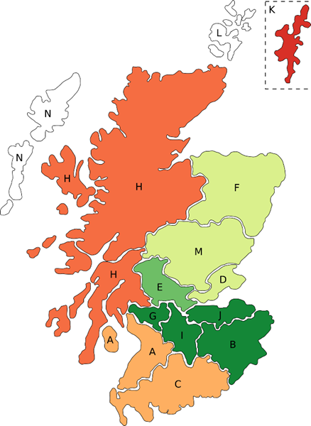

Consultant Workforce

Slide 15
Workforce
  Median 1.45 FTE geriatric medicine consultants per 10,000 ≥ 65 years (Range: 0.54 – 2.40)
  Greatest provision
    NHS Lothian
    NHS Greater Glasgow and Clyde
    NHS Lanarkshire
  Lowest provision
    NHS Highland
    NHS Dumfries and Galloway
    NHS Ayrshire and Arran
Contacts: g.ellis@nhs.net; phyo.myint@abdn.ac.uk

Slide 16
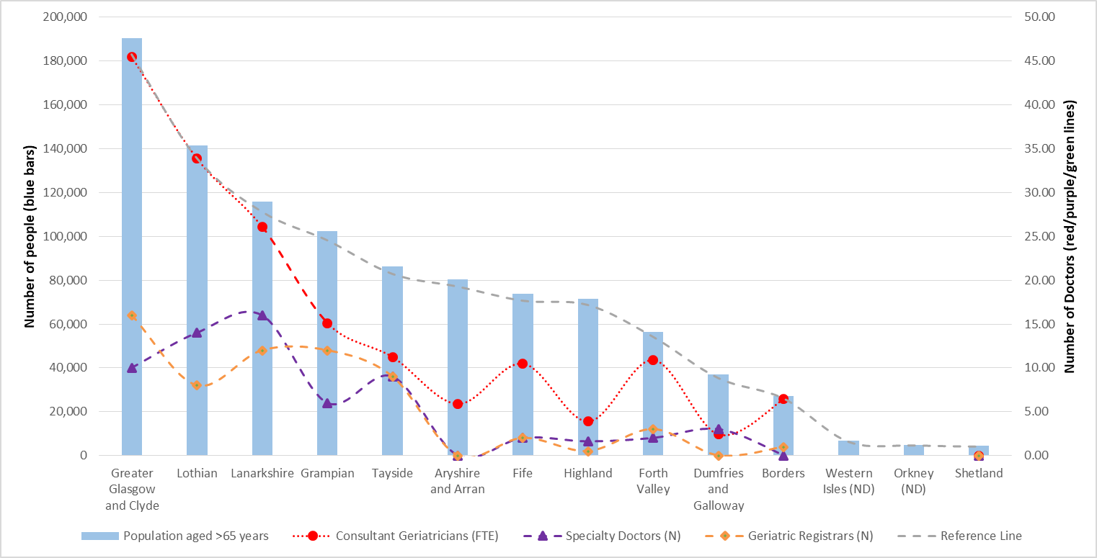
Workforce

Slide 17
Service Provision Scores
  Median Acute SPS 0.81 (Range: 0.50 – 0.89)
  Median Community SPS 0.60 (Range: 0.48 – 0.82)
Contacts: g.ellis@nhs.net; phyo.myint@abdn.ac.uk

Slide 18
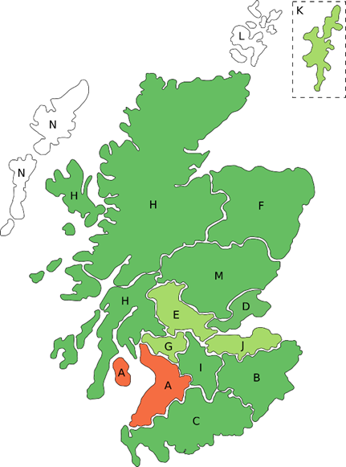
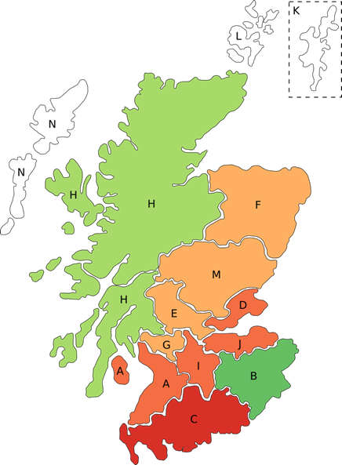

Acute
Community
Service Provision Score

Slide 19
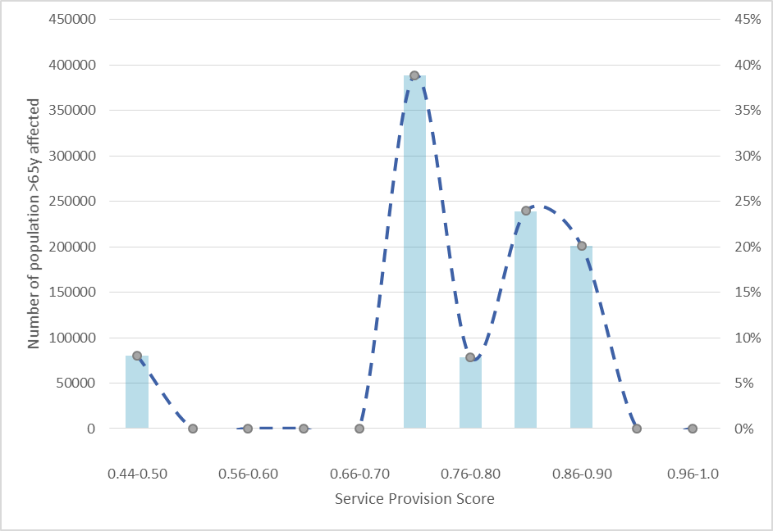
Number of Population affected by Service Provision Score

Slide 20
Discussion Points
Variation shown in reported data for acute and community services
This was a first step – assessment of service quality beyond remit
Inappropriate to draw comparisons based on scores of specific health boards
  Relied on ‘best of knowledge’
  No duplication for validation
  Next cycle will be complemented by population level data
Challenging to compare services that may not be exclusive to older people, and not all hospitals have a dedicated frailty unit
Ideally we would relate specialist service provision to number of frail individuals rather than over 65s
No adjustment for baseline health status of population in each board
No weightage for Service Provision Scores
Contacts: g.ellis@nhs.net; phyo.myint@abdn.ac.uk

Slide 21

Thanks to those who helped make phase 1 possible
Medical Students: Tiberiu Pana, Jesus Perdomo, Maryam Barma, Samuel Neal
Dr Claire Copland and Dr Tony Byrne (NHS Forth Valley)
Dr Louise Beveridge (NHS Tayside)
Dr Jennifer Burns and Dr Morven McElroy (NHS Greater Glasgow and Clyde)
Dr Andrew Coull (NHS Lothian)
Dr Alice Einarsson (NHS Shetland)
Prof Graham Ellis (NHS Lanarkshire)
Dr Graeme Hoyle (NHS Grampian)
Dr Allan MacDonald (NHS Highland)
Dr Terence Quinn (University of Glasgow)
Dr Susie Shenkin (University of Edinburgh)
Dr Rachel Stewart (NHS Borders)
Dr Ralph Thomas (NHS Fife)
Dr Andrew Watt (NHS Ayrshire and Arran)
Contacts: g.ellis@nhs.net; phyo.myint@abdn.ac.uk

Slide 22
Phase 2 Progress
Step 1: Audit of ‘Comprehensive Geriatric Assessment’
REDCAP Survey System
Representatives sought from all individual units providing acute care in Scotland (27 total)
So far 22 reps identified
18/22 have registered for online survey system
11/22 have completed their data collection
Contacts: g.ellis@nhs.net; phyo.myint@abdn.ac.uk

Slide 23
Phase 2 Progress
Step 2: Data Linkage
Grant applications submitted to fund
  E-DRIS data linkage
  Statistician
Contacts: g.ellis@nhs.net; phyo.myint@abdn.ac.uk

Slide 24
With grateful thanks to those supporting data collection
Ben Adler
Kathryn Anderson
Maryam Barma
Louise Beveridge
Bob Caslake
Amy Conley
Claire Copland
Andrew Coull
Alice Einarrson
Neil Henderson
Victoria Henderson
Innes Hynd
Douglas Lowdon
Allan MacDonald
Brian McInnes
Nuala McQuillan
Alistair McVean
Lara Mitchell
Latana Munang
James Myles
Susie Shenkin
Rachel Stewart
Rowan Wallace
Andrew Watt
Contacts: g.ellis@nhs.net; phyo.myint@abdn.ac.uk

Slide 25
Scottish Care of Older People (SCoOP) audit
- Future
Contacts: g.ellis@nhs.net; phyo.myint@abdn.ac.uk

Slide 26
Pre-hospital
Community
Acute geriatrics
discharge
Rehabilitation
Health promotion
Hospital @ home
Care home
Palliative care
Other specialties
Contacts: g.ellis@nhs.net; phyo.myint@abdn.ac.uk

Slide 27
Acute Geriatrics
Liaison
H@H
CGA
ED
Contacts: g.ellis@nhs.net; phyo.myint@abdn.ac.uk

Slide 28
Acute Geriatrics
Liaison
H@H
CGA
ED
Contacts: g.ellis@nhs.net; phyo.myint@abdn.ac.uk

Slide 29
Not meeting 4 hr ED waiting time in NHS Scotland
(January 2015-September 2018)
Age Group (Years) | Number Attending | % Seen Within 4 Hours | Odds Ratio (95% CI)
00-04 | 493,539 | 98.47 | 1.00 (0.97 - 1.03)
05-09 | 278,101 | 98.70 | 0.84 (0.81 - 0.88)
10-14 | 316,463 | 98.46 | 1.00 (0.97 - 1.04)
15-19 | 343,602 | 95.54 | 3.00 (2.92 - 3.09)
20-24 | 403,185 | 94.78 | 3.54 (3.45 - 3.64)
25-29 | 375,843 | 94.32 | 3.87 (3.77 - 3.98)
30-34 | 339,687 | 93.63 | 4.37 (4.26 - 4.49)
35-39 | 300,008 | 93.10 | 4.76 (4.63 - 4.89)
40-44 | 288,018 | 92.49 | 5.22 (5.08 - 5.36)
45-49 | 326,119 | 92.13 | 5.49 (5.35 - 5.63)
50-54 | 342,276 | 91.54 | 5.94 (5.79 - 6.09)
55-59 | 309,927 | 90.83 | 6.49 (6.32 - 6.66)
60-64 | 264,085 | 89.74 | 7.34 (7.15 - 7.54)
65-69 | 257,458 | 88.41 | 8.42 (8.21 - 8.64)
70-74 | 246,704 | 87.10 | 9.51 (9.27 - 9.76)
75-79 | 237,250 | 85.75 | 10.68 (10.41 - 10.95)
80-84 | 221,194 | 84.35 | 11.92 (11.62 - 12.23)
85+ | 253,642 | 82.76 | 13.39 (13.06 - 13.72)
Contacts: g.ellis@nhs.net; phyo.myint@abdn.ac.uk

Slide 30
Annual Acute SCoOP audits
SCoOP-CGA
SCoOP-ED
SCoOP-H@H/ACAH
SCoOP- Liaison services
---- Surgical
---- Ortho
---- Community
Contacts: g.ellis@nhs.net; phyo.myint@abdn.ac.uk

Slide 31
Join us please
& thank you for your participation
Full report of first audit available in JRCPE soon
Contacts: g.ellis@nhs.net; phyo.myint@abdn.ac.uk

