Slide 1
One SCoOP or two? Scottish Care of Older People - National Audit Comprehensive Geriatric Assessment
Dr Christine McAlpine, Dr Marc Locherty, Prof Phyo Myint
Contacts: g.ellis@nhs.net; phyo.myint@abdn.ac.uk

Slide 2
Second round of audit (2019)
Looking at comprehensive geriatric assessment in the acute setting
Particular focus on the make up of multidisciplinary team and how they help provide care
Survey designed and disseminated to consultant geriatricians known to and nominated by the BGS
Covered 13 of 14 health boards; responses for 26 of 29 hospitals
Data completed based on ‘best of their knowledge’
Contacts: g.ellis@nhs.net; phyo.myint@abdn.ac.uk

Slide 3
What data was collected?
Interface
Admission routes for patients – criteria and referral pathways
Dedicated Geriatric unit versus review in Acute Medicine
Use of frailty screening tools
Contacts: g.ellis@nhs.net; phyo.myint@abdn.ac.uk

Slide 4
What data was collected?
Staff involved in CGA
Number and contribution of medical staff – consultants, registrars, speciality doctors
Specialist nurses and their roles
Access to physiotherapy
Access to occupational therapy
Access to pharmacy, social work, discharge co-ordinators and old age psychiatry
Contacts: g.ellis@nhs.net; phyo.myint@abdn.ac.uk

Slide 5
What data was collected?
Linked services
Support to Emergency Department
Hospital at home service
Orthogeriatric service
Surgical liason service
Contacts: g.ellis@nhs.net; phyo.myint@abdn.ac.uk

Slide 6
How was data collected?
REDCap
Secure web application used to build and manage online surveys and databases
Allows for statistical analysis and easy exporting of data
Contacts: g.ellis@nhs.net; phyo.myint@abdn.ac.uk

Slide 7
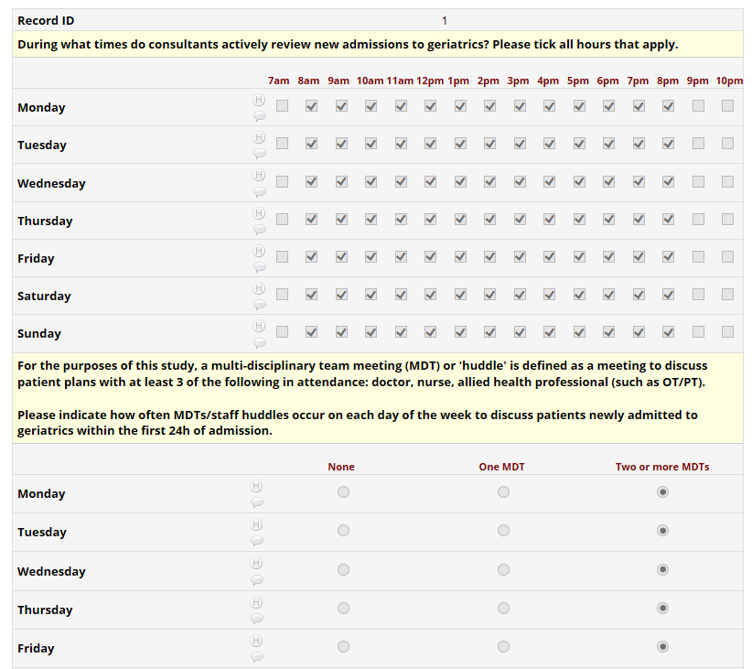
Contacts: g.ellis@nhs.net; phyo.myint@abdn.ac.uk

Slide 8
Initial data review
Overview of make up of different multidisciplinary teams across the country
Includes availability of physiotherapy and occupational therapy – does not represent number of therapists
Taken from REDCap responses from December 2018 through July 2019
Contacts: g.ellis@nhs.net; phyo.myint@abdn.ac.uk

Slide 9
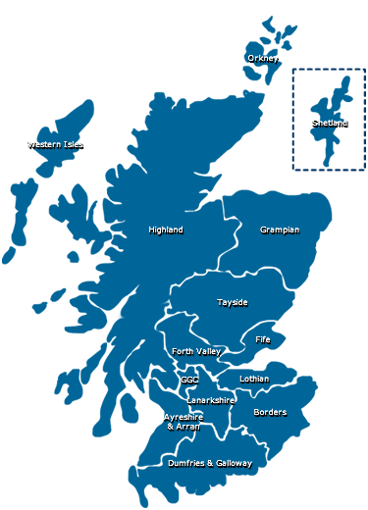
Contacts: g.ellis@nhs.net; phyo.myint@abdn.ac.uk

Slide 10
Victoria Hospital Kirkcaldy
Evening cover
Weekend cover
Dedicated therapist
Contacts: g.ellis@nhs.net; phyo.myint@abdn.ac.uk
Notes:
Social work input within 24 hours
Discharge co-ordinator specifically for Geriatric patients
Frequency of MDT meetings

Slide 11
Royal Infirmary of Edinburgh
Evening cover
Weekend cover
Dedicated therapist
Contacts: g.ellis@nhs.net; phyo.myint@abdn.ac.uk

Slide 12
Western General Hospital
Evening cover
Weekend cover
Dedicated therapist
Contacts: g.ellis@nhs.net; phyo.myint@abdn.ac.uk

Slide 13
St John’s Hospital
Evening cover
Weekend cover
Dedicated therapist
Contacts: g.ellis@nhs.net; phyo.myint@abdn.ac.uk

Slide 14
Borders General Hospital
Evening cover
Weekend cover
Dedicated therapist
Contacts: g.ellis@nhs.net; phyo.myint@abdn.ac.uk

Slide 15
Forth Valley Hospital
Evening cover
Weekend cover
Dedicated therapist
Contacts: g.ellis@nhs.net; phyo.myint@abdn.ac.uk

Slide 16
Queen Elizabeth University Hospital
Evening cover
Weekend cover
Dedicated therapist
Contacts: g.ellis@nhs.net; phyo.myint@abdn.ac.uk

Slide 17
Glasgow Royal Infirmary
Evening cover
Weekend cover
Dedicated therapist
Contacts: g.ellis@nhs.net; phyo.myint@abdn.ac.uk

Slide 18
Inverclyde Royal Hospital
Evening cover
Weekend cover
Dedicated therapist
Contacts: g.ellis@nhs.net; phyo.myint@abdn.ac.uk

Slide 19
Royal Alexandra Hospital
Evening cover
Weekend cover
Dedicated therapist
Contacts: g.ellis@nhs.net; phyo.myint@abdn.ac.uk

Slide 20
University Hospital Monklands
Evening cover
Weekend cover
Dedicated therapist
Contacts: g.ellis@nhs.net; phyo.myint@abdn.ac.uk

Slide 21
University Hospital Wishaw
Evening cover
Weekend cover
Dedicated therapist
Contacts: g.ellis@nhs.net; phyo.myint@abdn.ac.uk

Slide 22
Hairmyres
Evening cover
Weekend cover
Dedicated therapist
Contacts: g.ellis@nhs.net; phyo.myint@abdn.ac.uk

Slide 23
University Hospital Crosshouse
Evening cover
Weekend cover
Dedicated therapist
Contacts: g.ellis@nhs.net; phyo.myint@abdn.ac.uk

Slide 24
Ayr Hospital
Evening cover
Weekend cover
Dedicated therapist
Contacts: g.ellis@nhs.net; phyo.myint@abdn.ac.uk

Slide 25
Dumfries and Galloway
Evening cover
Weekend cover
Dedicated therapist
Contacts: g.ellis@nhs.net; phyo.myint@abdn.ac.uk

Slide 26
Ninewell’s Hospital
Evening cover
Weekend cover
Dedicated therapist
Contacts: g.ellis@nhs.net; phyo.myint@abdn.ac.uk

Slide 27
Perth Royal Infirmary
Evening cover
Weekend cover
Dedicated therapist
Contacts: g.ellis@nhs.net; phyo.myint@abdn.ac.uk

Slide 28
Western Isles Hospital
Evening cover
Weekend cover
Dedicated therapist
Contacts: g.ellis@nhs.net; phyo.myint@abdn.ac.uk

Slide 29
Aberdeen Royal Infirmary
Evening cover
Weekend cover
Dedicated therapist
Contacts: g.ellis@nhs.net; phyo.myint@abdn.ac.uk

Slide 30
Dr Gray’s Hospital
Evening cover
Weekend cover
Dedicated therapist
Contacts: g.ellis@nhs.net; phyo.myint@abdn.ac.uk

Slide 31
Raigmore Hospital
Evening cover
Weekend cover
Dedicated therapist
Contacts: g.ellis@nhs.net; phyo.myint@abdn.ac.uk

Slide 32
Wick Hospital
Evening cover
Weekend cover
Dedicated therapist
Contacts: g.ellis@nhs.net; phyo.myint@abdn.ac.uk

Slide 33
Belford Hospital, Fort William
Evening cover
Weekend cover
Dedicated therapist
Contacts: g.ellis@nhs.net; phyo.myint@abdn.ac.uk

Slide 34
Lorn and Islands Hospital
Evening cover
Weekend cover
Dedicated therapist
Contacts: g.ellis@nhs.net; phyo.myint@abdn.ac.uk

Slide 35
Gilbert Bain Hospital
Evening cover
Weekend cover
Dedicated therapist
Contacts: g.ellis@nhs.net; phyo.myint@abdn.ac.uk

Slide 36
Scottish Care of Older People (SCoOP) audit Summary and Update
Contacts: g.ellis@nhs.net; phyo.myint@abdn.ac.uk

Slide 37
SCoOP Structure
STEERING GROUP
Founding-members
BGS Scotland Council nominated Representatives from Scottish NHS Health Boards
Healthcare Improvement Scotland Representatives
Representatives from relevant societies and groups
Members of academic subgroup
Group Secretary
ACADEMIC SUBGROUP
WORKING GROUP
Chair
Members
Members of writing group (usually working group members and members of academic subgroup)
Current working groups: SCoOP Acute Care, SCoOP CGA, SCoOP Hospital @ Home
Work in progress: SCoOP Pharmacy, SCoOP Surgical Liaison (in collaboration with ELLSA), SCoOP ED
Contacts: g.ellis@nhs.net; phyo.myint@abdn.ac.uk

Slide 38
BGS Scotland Council Representatives
NHS Health Board | Current | Previous
Ayrshire and Arran | Dr Andrew Watt
Borders | Vacancy
Dumfries and Galloway | Dr Amy Conley
Western Isles | Vacancy
Fife | Dr Ralph Thomas
Forth Valley | Dr Tony Byrne
Grampian | Dr Graeme Hoyle
Greater Glasgow and Clyde | Dr Morven McElroy
Highland | Dr Allan MacDonald
Lanarkshire | Dr Graham Ellis
Lothian | Dr Kathryn Anderson | Dr Andrew Coull (Nov 2017- Nov 2019)
Orkney | Vacancy
Shetland | Vacancy | Dr Alice Einarsson (Nov 2017- Nov 2019)
Tayside | Dr Louise Beveridge
Contacts: g.ellis@nhs.net; phyo.myint@abdn.ac.uk

Slide 39
New members
Mr Scott Buchanan- NHS Scotland
Dr Patricia Cantley- BGS Scotland
Ms Geraldine Jordan- Healthcare Improvement Scotland
Miss Susan Moug- Emergency Laparotomy and Laparoscopy Scottish Audit
Mr George Ramsay- Scottish Surgical Research Group
Dr Roy L Soiza- Scottish Society of Physicians
Ms Kathryn Wood- Pharmacy SIG
Contacts: g.ellis@nhs.net; phyo.myint@abdn.ac.uk

Slide 40
Progress Report (2019)
SCoOP Acute- 2017-2018 report; associated press release and media attention (in BBC and STV news); 1k from UoA for publishing report.
SCoOP CGA- survey completed; in the process of data application from ISD; Secretary Dr Donaldson received funding from BGS (10K) to purchase data and statistician time; reports in due course.
SCoOP ED- small working group; using publicly available data (presented in EUGMS and CSO NRS Meetings in 2018, short report with Emergency Medicine Journal (Jonathan Quinn-2 MBChB was supported by “Leslie Wilson Scholarship” NHS Grampian)- revision stage.
Main BGS support: £1,000 for design and leaflets/pull ups for promotional purpose
Registration as a Scottish National Audit Programme: in progress
Contacts: g.ellis@nhs.net; phyo.myint@abdn.ac.uk

Slide 41
With grateful thanks to those supporting data collection
Ben Adler
Kathryn Anderson
Maryam Barma
Louise Beveridge
Bob Caslake
Amy Conley
Claire Copland
Gordon Caldwell
Alice Einarrson
Neil Henderson
Lara Mitchell
Ralph Thomas
Victoria Henderson
Innes Hynd
Douglas Lowdon
Allan MacDonald
Brian McInnes
Alistair McVean
Lara Mitchell
Latana Munang
James Myles
Lucy McCracken
Susie Shenkin
Rachel Stewart
Rowan Wallace
Andrew Watt
Contacts: g.ellis@nhs.net; phyo.myint@abdn.ac.uk

