Slide 1



Important variations in care of the elderly services
Medical Trainees: On-call Handbook Symposium 2020
Contact: alison.donaldson@abdn.ac.uk

Slide 2
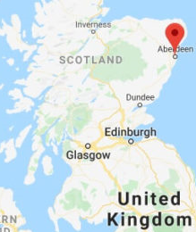

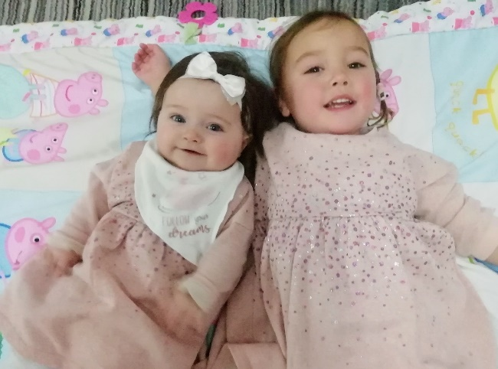
Contact: alison.donaldson@abdn.ac.uk

Slide 3
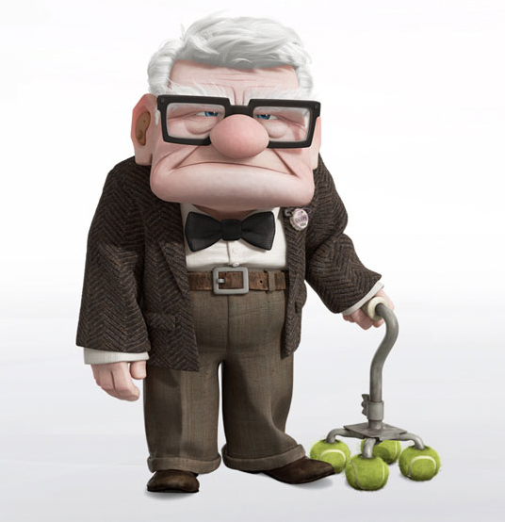


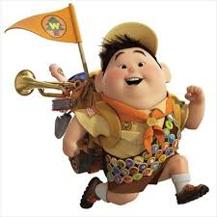

Admitted for investigations
48h wait over weekend for non-urgent CT head
No PT/OT ward cover OOH
Deconditions
Difficulty mobilising, needs care for discharge
Carl
Lives alone
Mobile with stick
New delusional ideas about flying in house
GP letter: ?UTI
Early comprehensive geriatric assessment
Early collateral Hx
Same day MDT meeting - agreed best managed at home
Discharged within 24h
Contact: alison.donaldson@abdn.ac.uk
Notes:
So clearly this is a very exaggerated story, but I hope it serves to illustrate the importance of ensuring that when a frail older adult pitches up an the front door of the hospital, that there is no postcode lottery in ensuring the best possible specialist services for them.
I’m delighted to have this opportunity to speak to you today. We’re all here as trainees – not all geriatricians - so I’ll try and keep this interesting for everyone.
However, I know that it won’t come as news to any of you that our UK population is ageing. And I’m sure that regardless of your specialty many, if not all of you will have had a conversation at some point about where the best place is to care for a frail older adult presently acutely to hospital. This is obviously a very exaggerated story, but the care pathway of a frail older adult presenting acutely unwell could be quite different depending on the hospital, but does anyone really know what is best? Should they go straight to the care of a geriatrician? Do all of our hospitals have geriatricians, and do they have enough to meet demand?

Slide 4
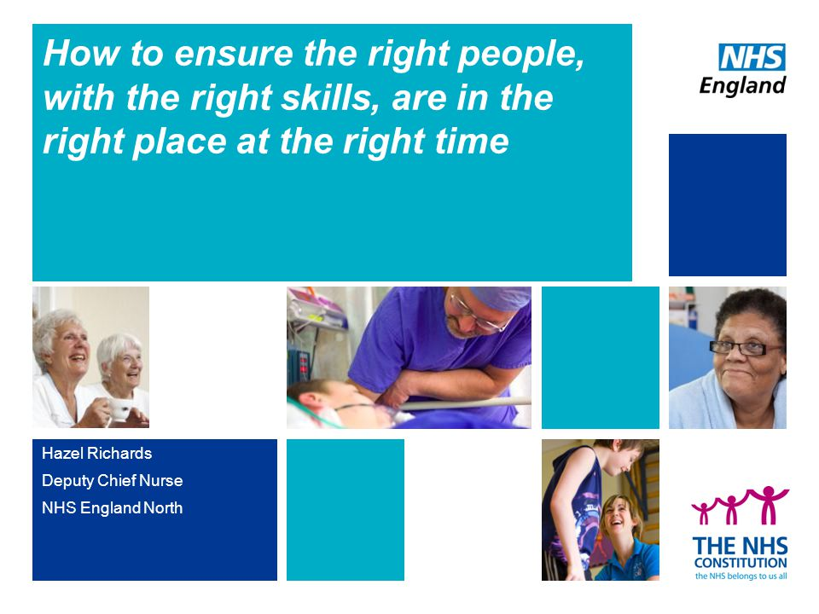

Slide 5
Background
Hospitals regularly inspected and reports produced
No data on how services for frail older adults are provided
No existing gold standard as a ‘good practice guide’
Collaboration made between:
  University of Aberdeen
  British Geriatrics Society
  Healthcare Improvement Scotland
Developed the ‘Scottish Care of Older People’ (SCoOP) programme
Notes:
Ultimately wish to optimise services for older people with frailty in Scotland
Acknowledge Prof Graeme Ellis, Prof Phyo Myint and Dr Christine McAlpine

Slide 6
What is SCoOP?
National audit programme
Assesses specialist service provision for older people with frailty in Scotland
Launched in Nov 2017
Scottish Care of Older People (SCoOP) Audit Programme
Notes:
Talk about hip fracture audit

Slide 7
What are the goals of SCoOP?
Improve patient safety, quality and standards of care
For services to learn from each other
Ensure fair and equitable access to care
Highlight service variations and help avoid a ‘postcode lottery’ in the care an older person receives
Inform the work of Health and Social Care partnerships across Scotland
Set gold standards as a good practice guide
Scottish Care of Older People (SCoOP) Audit Programme
Notes:
Health and care partnerships responsible for delivering care

Slide 8
First round of audit (2018)
Intended as a ‘scoping exercise’
To establish if basic differences in services existed
To aid planning and funding of future in-depth audit
Simple survey designed and disseminated to consultant geriatricians known to and nominated by the BGS
  Covered 12 of 14 health boards
Data completed based on ‘best of their knowledge’
Scottish Care of Older People (SCoOP) Audit Programme

Slide 9
Comprehensive
Geriatric
Assessment
Social Support & Mental Status
Polypharmacy
Nutrition
Functional Status
Co-morbidity
Cognition
“a multidimensional, multidisciplinary diagnostic and therapeutic process to determine the medical, mental and functional problems of older people with frailty”
Scottish Care of Older People (SCoOP) Audit Programme
Notes:
Within geriatric medicine, the concept of CGA is well-embedded – this being a multidimensional, multidisciplinary diagnostic and therapeutic process to determine the medical, mental and functional problems of older people with frailty. A Conchrane review in 2017 concluded that older patients are more likely to be alive and in their own homes at follow up if they received a CGA on admission to hospital. In 2016 the NHS England Benchmarking Network reported that 52% of trusts had a frailty unit and 89% of frailty units use CGA, but just 3% of the consultant workforce in older peoples care were geriatricians.
We all know about CGA
We all think we are doing CGA
But are we doing it effectively?
Could we do it better?
Could we learn from other centres?

Slide 10
What data was collected?
Workforce
  Consultants (10 sessions = one FTE)
  Speciality doctors and Registrars (number only)
  National records for Scotland data on health board catchment population to calculate numbers per 10,000 population ≥ 65 years
Scottish Care of Older People (SCoOP) Audit Programme

Slide 11
What data was collected?
Service Provision
  Four acute service components used to calculate a service provision score (min=0 ; max=1)
  Each aspect contributed 25% of total score
  Mean was taken for all units in a given health board
Days of operation | MDT meeting frequency
Physiotherapy availability | Occupational therapy availability

Slide 12
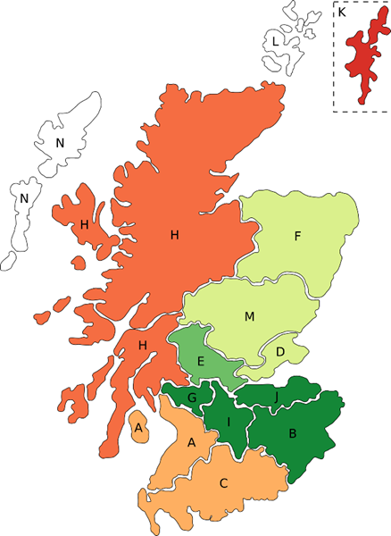

  Median 1.45 FTE /10,000 ≥65 years
  (Range: 0.54 – 2.40)
Consultant Geriatrician Workforce

Slide 13
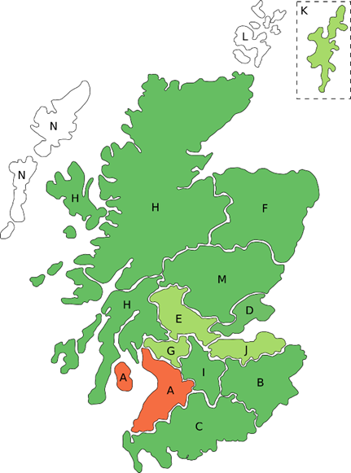
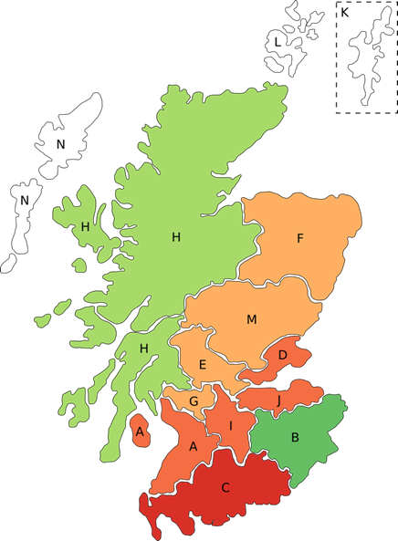

Acute
Community
  Median SPS 0.81
  (Range: 0.50 – 0.89)
  Median SPS 0.60
  (Range: 0.48 – 0.82)
Service Provision Score

Slide 14
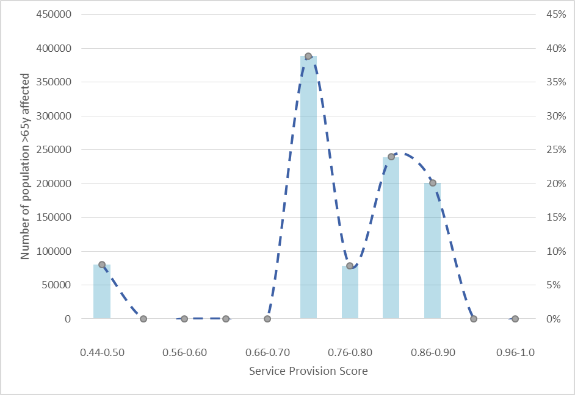
Number of Population affected by Service Provision Score
Notes:
Inappropriate to draw comparisons based on scores of specific health boards
Relied on ‘best of knowledge’
No duplication for validation
Next cycle will be complemented by population level data

Slide 15
Limitations and challenges of the project
Comparison of services that may not be exclusive to older people, as not all hospitals have a dedicated frailty unit/ staff may cover multiple areas
No weightage for Service Provision Scores
No adjustment for baseline health status of population in each board
Ideally we would relate specialist service provision to number of frail individuals rather than over 65s
Notes:
3) You acknowledge in the paper that your analysis did not adjust for baseline health status (or area deprivation) and that you did not assign weighting to service scores, when, presumably, the number of days the various services operated/wk may be the most important. These matters would be worth touching on.

Slide 16
Considering Frailty
Clinically recognisable aging-related state of vulnerability
High risk for: mortality; falls; disability; hospitalization
Fried Criteria (3-5/5 = frail)
  Weight loss
  Weakness (grip strength)
  Exhaustion
  Slowed walking speed
  Low activity

Slide 17
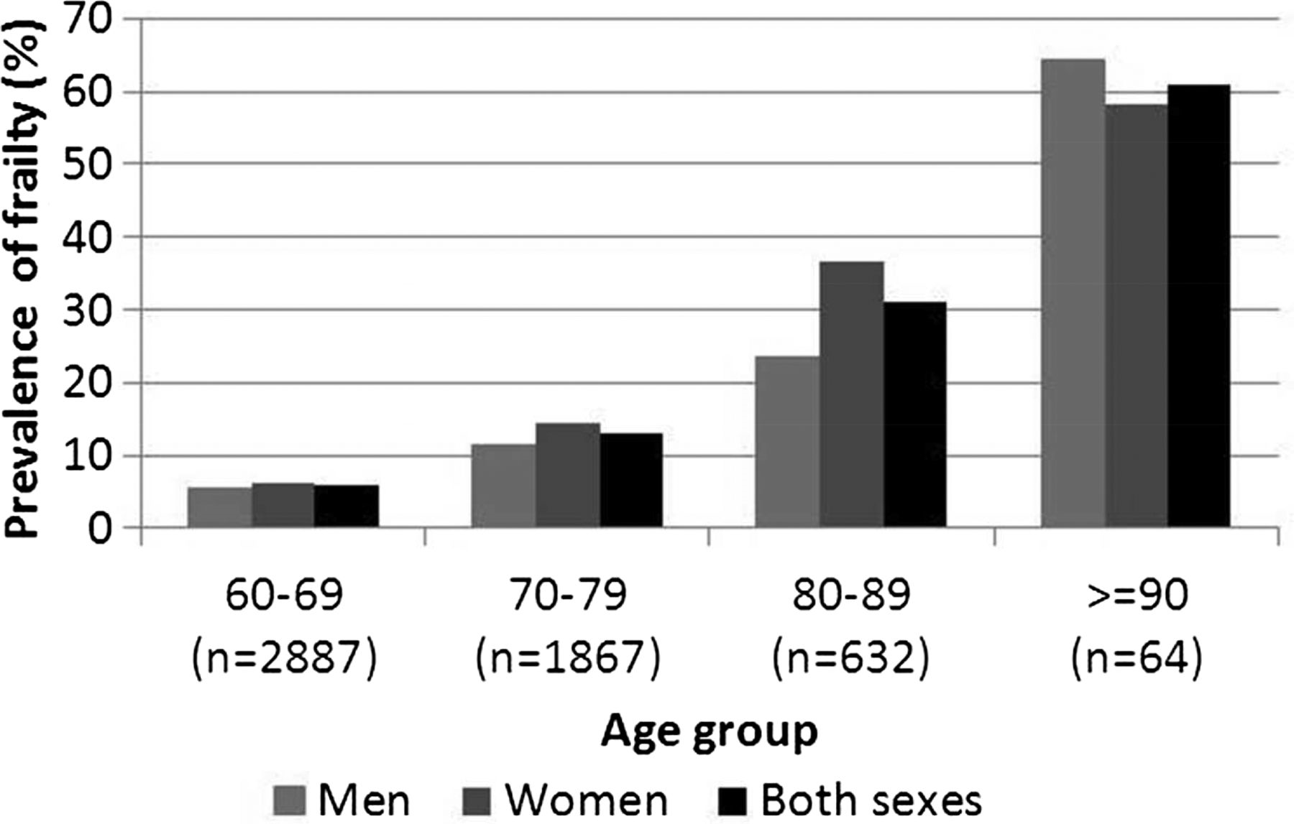
Considering Frailty
Notes:
Prevalence of frailty in over 60s ~ 14% (Gale et al, 2014)
6.5% age 60-69y and 65% age ≥ 90y

Slide 18

One SCoOP or Two?
Data collection complete for second detailed audit using REDCAP system
Focus on CGA in the acute setting
  Admission routes
  Frailty screening tools
  Linked services e.g. hospital at home, orthogeriatrics
Responses from 26/29 Scottish hospitals
Funding secured via BGS STR Grant to cover ISD data acquisition and statistician time

Slide 19

Even more SCoOPs?
Current working groups:
SCoOP Acute Care
SCoOP CGA
SCoOP Emergency Department
Work in progress:
SCoOP Pharmacy
SCoOP Surgical Liaison (in collaboration with ELLSA)
SCoOP Hospital @ Home

Slide 20

Interested in SCoOP?
Contact: alison.donaldson@abdn.ac.uk / phyo.myint@abdn.ac.uk

Slide 21
Important variations in care of the elderly services – Summary Slide
Figure 1
The Scottish Care of Older People (SCoOP) project is a national audit which assesses specialist service provision for frail older adults
SCoOP aims to provide fair and equitable access to high quality care and establish ‘gold standards’
The initial ‘scoping exercise’ has shown variation in the consultant geriatrician provision in Scotland (fig.1) and in acute and community service provision scores
Data collection for an in-depth second cycle has now been completed, and a BGS SPR Research Start Up Grant has been awarded, enabling findings to be correlated with ISD health intelligence data
Further working groups have been established to focus on other aspects of care for frail older adults including surgery, pharmacy and emergency medicine
Contacts: alison.donaldson@abdn.ac.uk / phyo.myint@abdn.ac.uk

