Slide 1

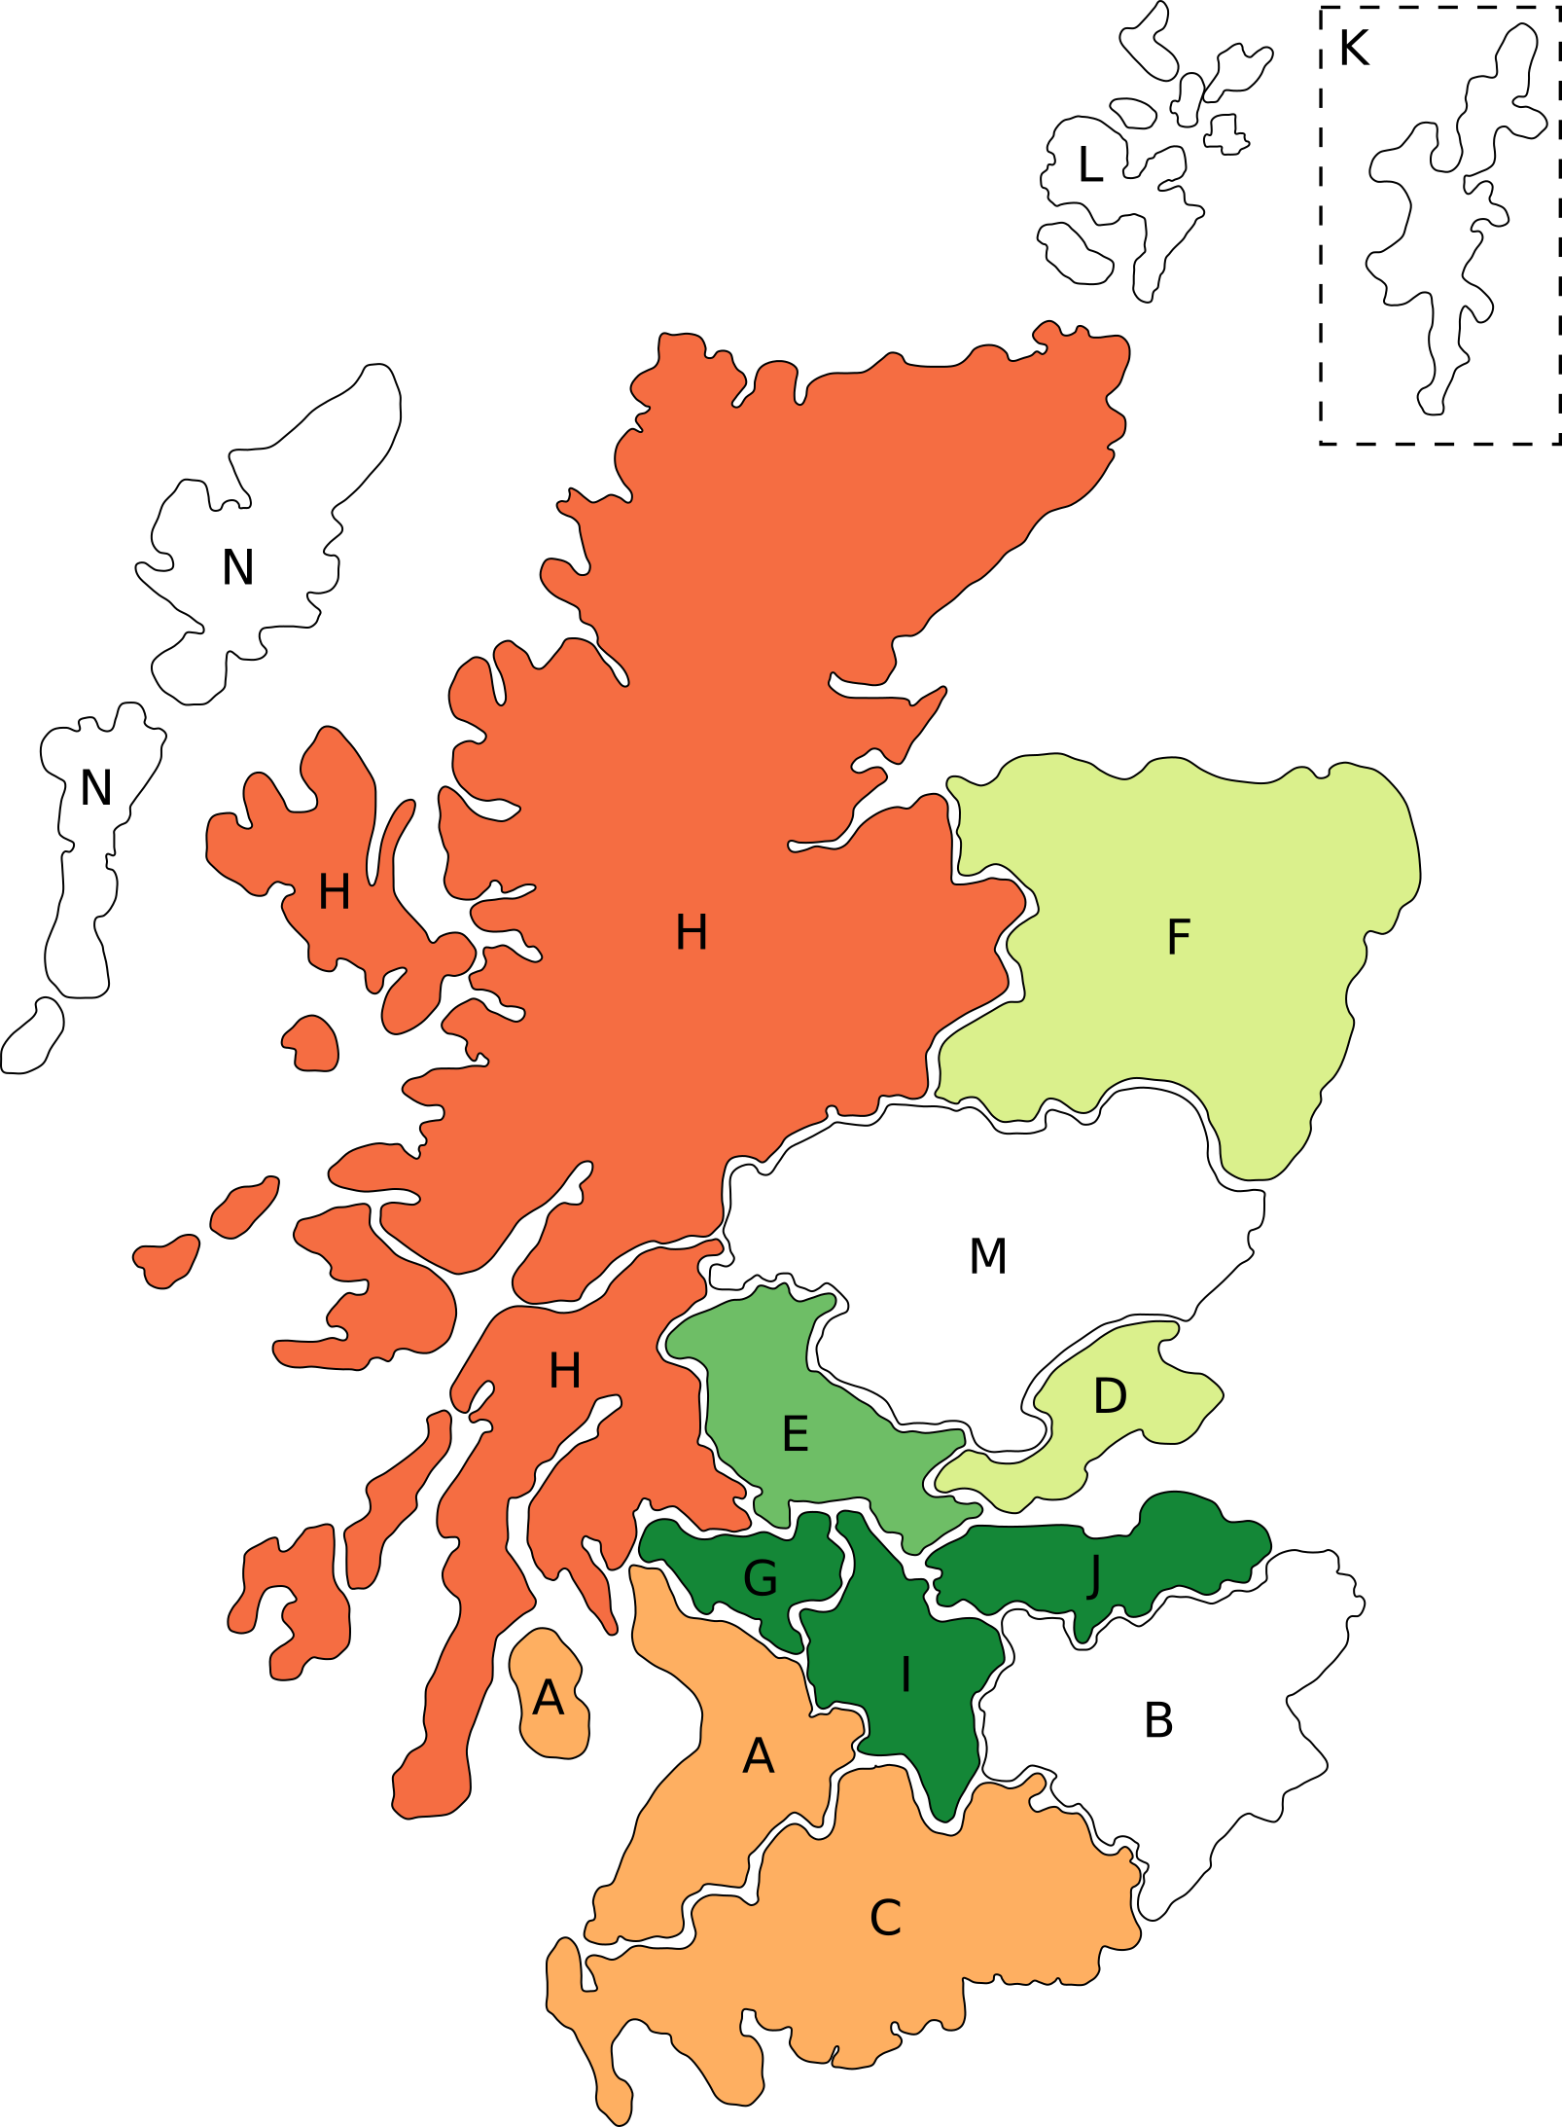
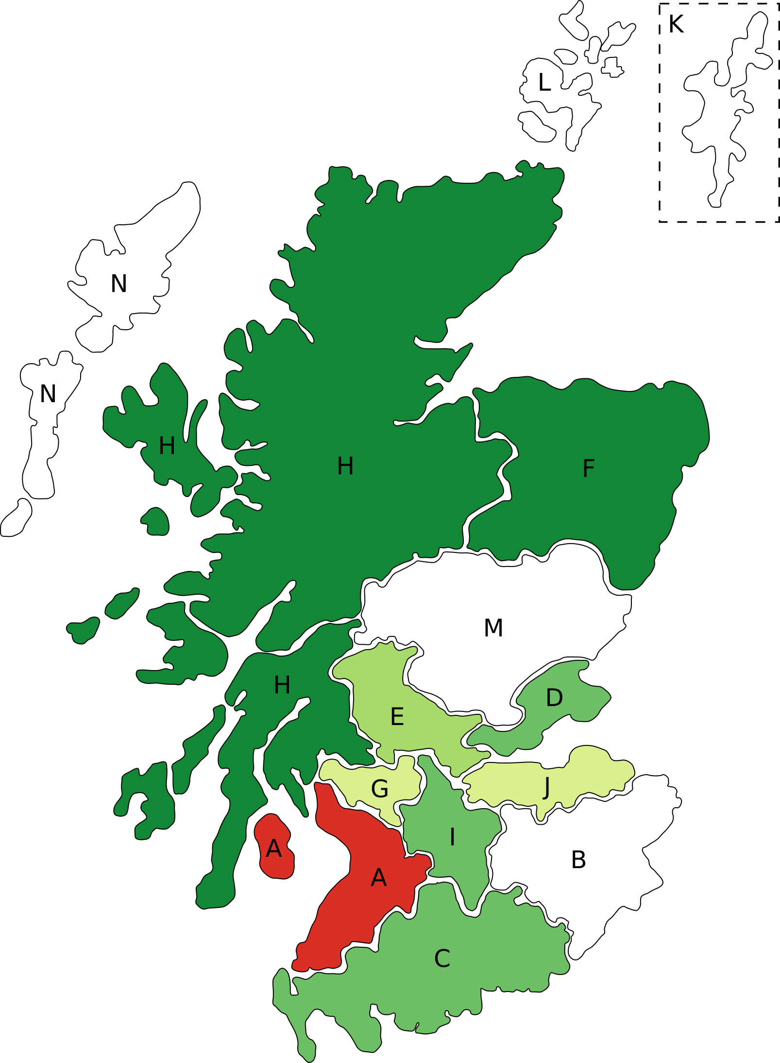
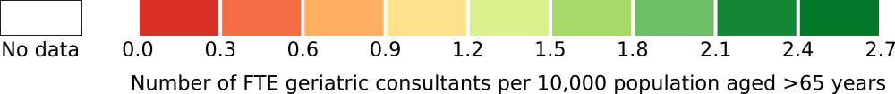
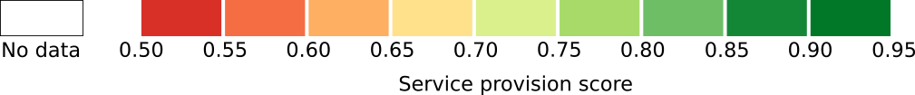


Scottish Care of Older People (SCoOP): initial scoping survey results
Tiberiu A. Pana, Samuel R. Neal, Jesus A. Perdomo and Alison IC. Donaldson on behalf of the SCoOP Steering Group
Correspondence to: SCoOP Secretariat, Room 1.130, Polwarth Building, Ageing Clinical & Experimental Research Team, University of Aberdeen. Tel: +44 (0) 1224 437963.
Background
Whilst older people (aged ≥65 years) are a major group of patients who use acute medical and surgical services, the speciality service provision for older people with frailty has not been systematically assessed throughout Scotland. The Scottish Care of Older People (SCoOP) national audit was launched in November 2017 and will provide benchmarking tools to further improve the care standards for older people across the nation, benefiting patients, the public, the National Health Service and policy makers alike. An initial scoping survey was carried out in early 2018 and the results of consultant workforce data and acute service provision are presented.
Figure 2
A: Number of FTE consultant geriatricians employed by each health board per
10,000 population aged over 65 years.
B: Acute service provision score for each health board.
A
B
Methods
A Microsoft Excel spreadsheet was designed and tested in two hospitals prior to distribution to the SCoOP Steering Group. Each representative member of the health board completed data entry based on ‘best of their knowledge’ information.
Data on consultant workforce were calculated based on sessional commitment, with 10 sessions equalling one full-time equivalent (FTE). Data on health board catchment population¹ were used to calculate the number of FTE geriatric consultants per 10,000 population aged over 65 years for each health board.
Four acute service components were used to calculate a service provision score from 0 to 1.0. Service components are:
  Number of days in operation;
  MDT hub frequency;
  Availability of physiotherapy services;
  Availability of occupational therapy services.
A score for each service component was calculated by dividing the number of days each component occurs or is available for each unit of a health board by the maximum number of days. For those units where physiotherapy and occupational therapy are available on an ‘on request’ basis, this was counted as being available 2 days a week.
The total acute service provision score was then calculated by adding the service component scores together and dividing by 4. Hence, each service component forms a quarter of the total score.
A service provision score of 1.0 represents a hypothetically ideal health board delivering full acute geriatric services at every unit on every day of the week.
A = NHS Ayrshire & Arran
B = NHS Borders
C = NHS Dumfries & Galloway
D = NHS Fife
E = NHS Forth Valley
F = NHS Grampian
G = NHS Greater Glasgow & Clyde
H = NHS Highland
I = NHS Lanarkshire
J = NHS Lothian
K = NHS Shetland
L = NHS Orkney
M = NHS Tayside
N = NHS Western Isles
Results
The response rate was 71%, although incomplete data received for Tayside and Shetland were excluded from the analysis.
There is a wide variation in the size of the population aged over 65 served by each health board with mean population of 71,347 (Figure 1).
Similarly, the number of FTE geriatric consultants per 10,000 older people aged >65 years varies widely across the Scottish health boards (Figure 2A), with a mean of 1.5 FTE geriatric consultants per 10,000 population >65 years (SD 0.76).
The greatest consultant provision among responding health boards was in NHS Lothian, NHS Greater Glasgow & Clyde and NHS Lanarkshire, with 2.40, 2.39 and 2.25 FTE geriatric consultants per 10,000 older people, respectively.
NHS Highland, NHS Dumfries & Galloway and NHS Aryshire & Arran had the lowest scores in this regard, all with less than 1 FTE geriatrician per 10,000 older people (0.54, 0.65 and 0.73, respectively).
The mean national service provision score was 0.80 (SD 0.12; 95% CI 0.56-1.00) as shown in Figure 2B.
Service provision scores were highest in NHS Grampian and NHS Highland (0.89 and 0.86, respectively), and lowest in NHS Ayrshire & Arran (0.50).
Figure 1: Share of Scottish population aged >65 years covered by each health board
Conclusion
In this initial scoping study, we can already see variation in acute specialist service provision for older adults across Scotland. Each health board serves a very different population, not just in terms of number, but in geographical area, and it is important to bear this in mind when considering the impact of results. This provisional analysis has not included any adjustment for the baseline health of the population of over 65s in each board, which would be expected to influence the demand for specialist geriatric services.
Since the data were largely based on ‘best of knowledge’ information from representative members from each Health Board there may be inaccuracies. Future surveys will build on this preliminary information to accurately audit and improve care standards for older people across the nation, with an ultimate aim to make Scotland a centre of excellence which sets the benchmark internationally for the care of older people.
SCoOP Steering Group
Co-chairs: | Prof PK Myint¹ and Prof G Ellis²
Secretary: | Dr AIC Donaldson¹
Members: | Dr L Beveridge³, Prof C Black⁴, Dr T Byrne⁵, Ms P Bond⁶, Dr J Burns⁷, Dr A Conley⁸, Dr A Coull⁹, Dr A Einarsson¹⁰, Dr G Hoyle¹¹, Ms K Goudie⁶, Dr A MacDonald¹², Dr C McAlpine⁶, Dr M McElroy¹³, Dr T Quinn¹⁴, Dr S Shenkin¹⁵, Dr R Thomas¹⁶ and Dr A Watt¹⁷
Acknowledgments: | Dr Claire Copeland⁵
(1) University of Aberdeen; (2) NHS Lanarkshire; (3) NHS Tayside; (4) Grampian DASH; (5) NHS Forth Valley; (6) HIS; (7) BGS Scotland; (8) NHS Dumfries & Galloway; (9) NHS Lothian; (10) NHS Shetland; (11) NHS Grampian; (12) NHS Highland; (13) NHS Glasgow & Clyde; (14) University of Glasgow; (15) University of Edinburgh; (16) NHS Fife; (17) NHS Ayrshire & Arran
References
National Records of Scotland. Mid-2016 Population Estimates Scotland. National Records of Scotland; 2017. Available at: https://www.nrscotland.gov.uk/statistics-and-data/statistics/statistics-by-theme/population/population-estimates/mid-year-population-estimates/mid-2016. Accessed April 5, 2018.

